Slide 1
Data Interface Layout

Slide 2
Groupmates:
Chan Cheuk Ni
Cheuk Chun Ham
Cheung Wan Yeung
Chung Wing Tung
Lei Hau Yan

Slide 3
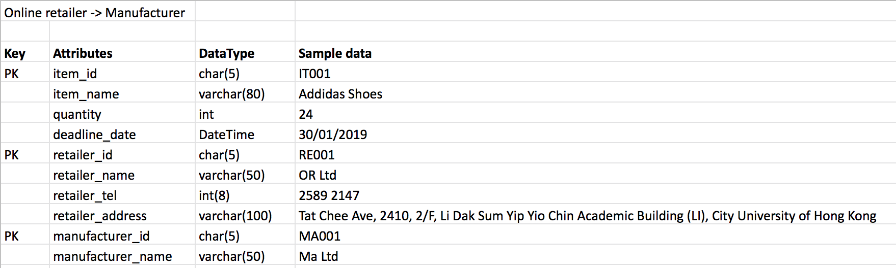
Online retailer → Manufacturer

Slide 4
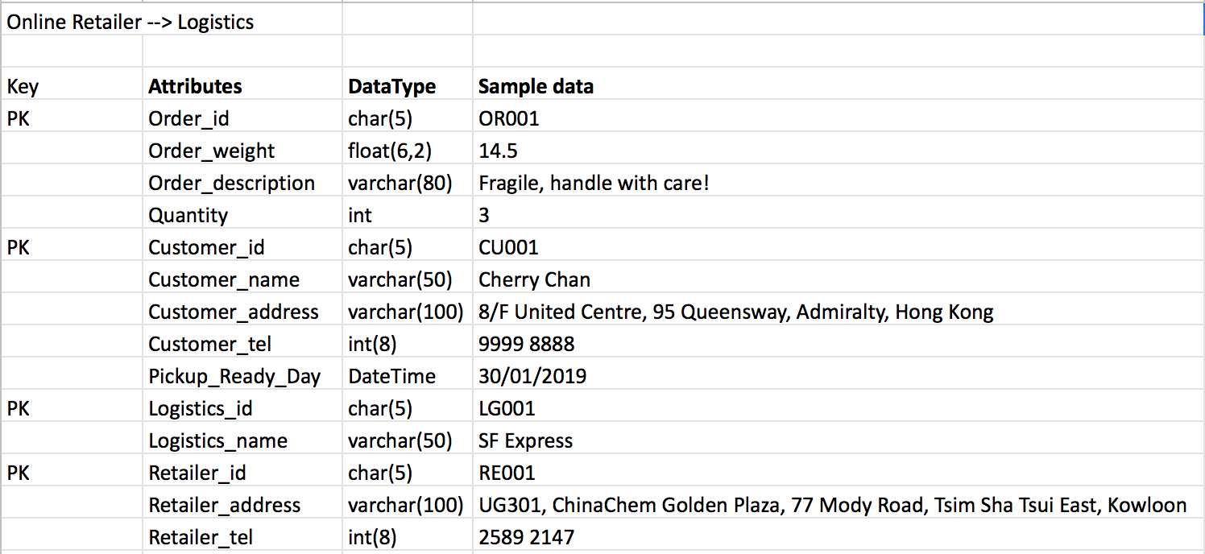
Online retailer → Logistics

